Slide 1
Planned ‘defections’

Slide 2
Problem structure
Start state where task can be tried which takes some effort. If tried, then leads to probabilistic transitions to easy or hard states which take different amounts of effort to finish the task
There is an option to shirk in each of these states

Slide 3
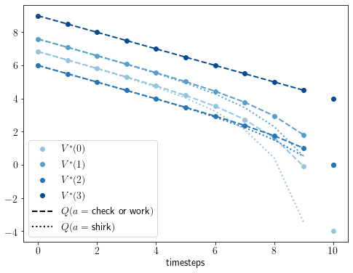
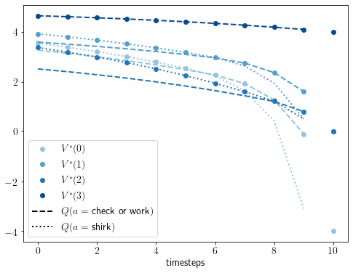
Without discounting, no delays in checking or working (abandon if costs are prohibitive) Discounting leads to delays
Efforts(check, work_easy, work_hard) = -0.1, -0.2, -1.0
Rewards(pass, uncompleted, fail, shirk) = 4.0, 0.0, -4.0, 0.5
Efficacy = 0.5; probability of transitions to easy and hard = (0.9, 0.1)
γ =1
γ =0.9
With discounting, in this param regime, checking on timestep = 6 and an unlikely transition to the difficult state means delaying working further until step = 9. So continuing working is delayed further due to unlikely toughness.

Slide 4
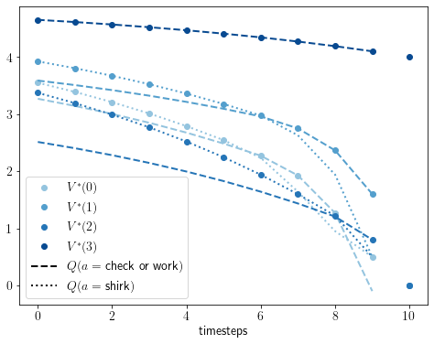
if consequences of failing not very high, then unnecessary to check in the final timestep
Reward_fail = 0.0

Slide 5
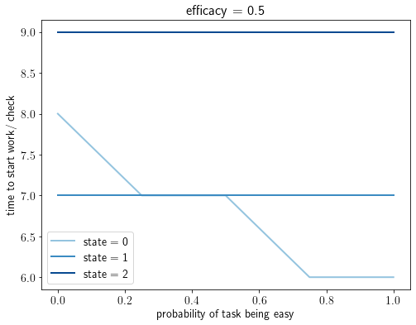
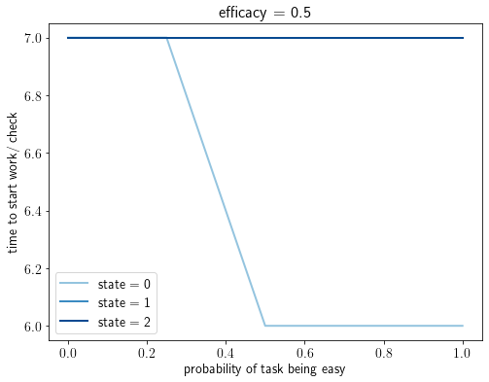
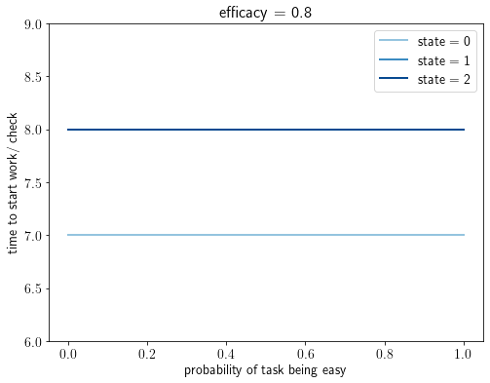
How do delays in checking depend on the probability of task being easy/ hard? More likely that the task is hard, better to check into task later. When difference between hard and easy states reduces due to high efficacy or low difference in efforts to work, this effect disappears.
Effort(easy, hard) = -0.1, -1.0
Effort(easy, hard) = -0.1, -0.5

Slide 6
In sum, efficacy, reward structure etc determine when to start working in the two work states independent of what happens in the starting state as there is no transition back. When to check is determined by all these factors AND the probabilities of task being easy or hard
In the case that the task is tough unlikelily, there is a planned ‘defection’ further into the future

